Slide 1
Group 1: Predictive Statistical Problems Assignment Part 2
Andre R. C. Junior,
Bruno A. L. Sassi,
Luciana A. Q. Popa, and
Tiago C. Ceolato.
Master of Data Analytics, University of Niagara Falls Canada
Predictive Analytics (DAMO-510-1)
Dr. Zeeshan Ahmad
June, 2025

Slide 2
Project Goal & Motivation
Predicting health issues using machine learning.
Model based on addictive behaviors & lifestyle factors.
Motivation
Lifestyle choices impact 60% of overall health.
Dataset
Synthetic, 3,000 individuals, has_health_issues target.
Key Features
Smoking, drinking, age, exercise, diet, sleep, BMI, and mental health.
2

Slide 3
Methodology: Data Preparation
Dataset Overview
Initial Cleaning
Synthetic data from 3,000 individuals.
Removed non-informative columns (ID, Name, City).
Missing Values
Data Types
education_level: Imputed using mode.
social_support, therapy_history: Filled with 'Unknown’ category.
Ensured correct formatting for all variables.
3

Slide 4
Data Preparation: Key Steps
Started with 3,000 individual records.
Focused on cleaning for predictive tasks.
Strategic handling of missing data to retain valuable records.
Ensured data readiness for analysis and modeling.
Removing Irrelevant Columns
Handling Missing Data
Data Type Validation
4

Slide 5
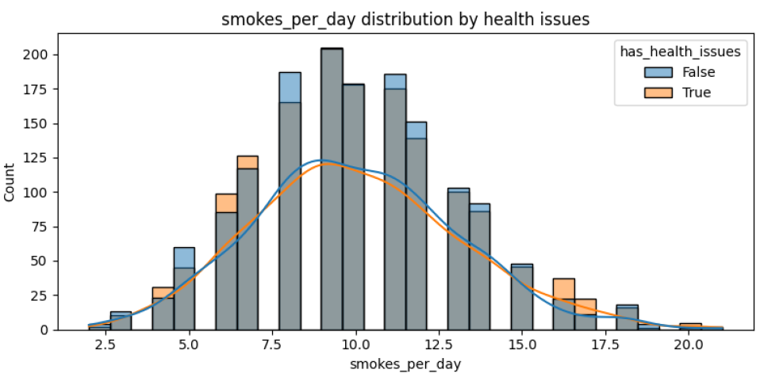
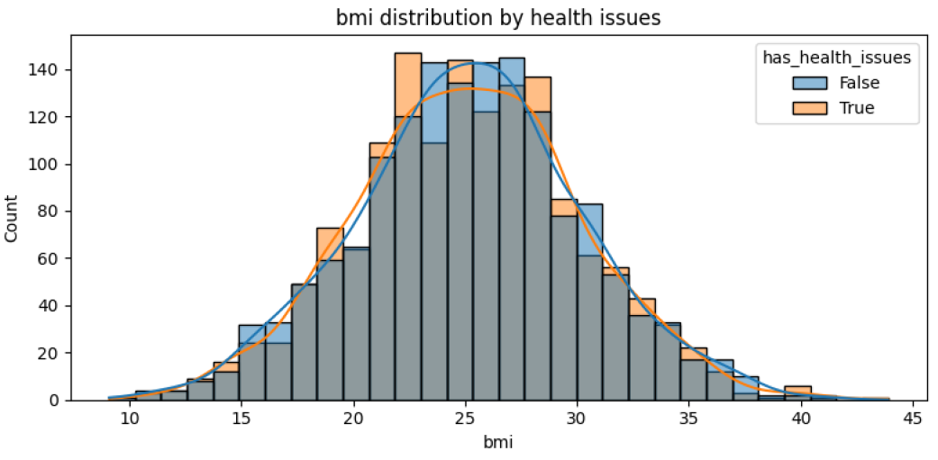
Methodology: Exploratory Data Analysis (EDA)
Target Distribution: Analyzed balance of has_health_issues (true/false).
Numeric Feature Distributions: Age, BMI, smokes/drinks per day vs. health issues.
Categorical Feature Distributions: Gender, mental health, diet quality vs. health issues.
Correlations: Identified linear relationships between numerical variables.
5

Slide 6
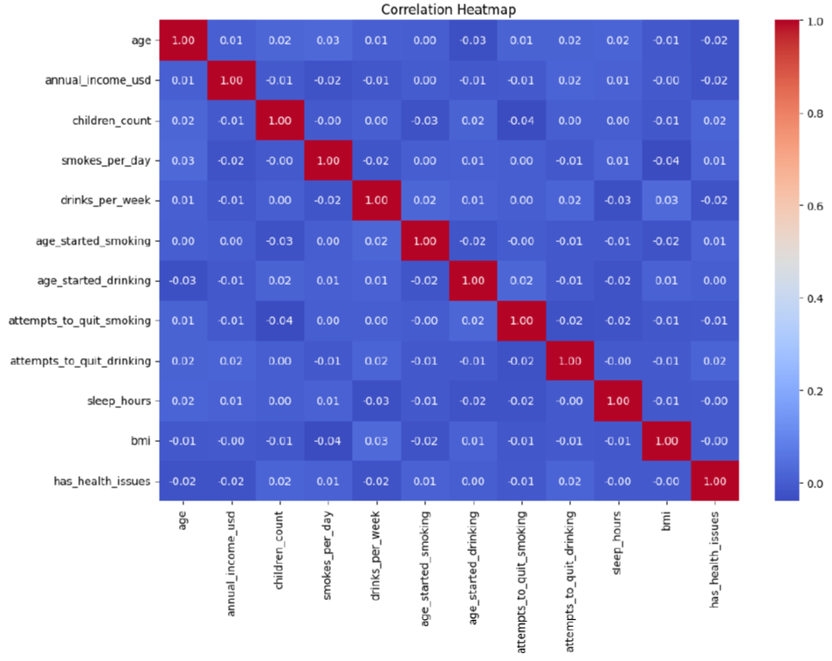
EDA: Insights & Patterns
Understanding underlying data patterns was critical.
Examined target variable balance and feature distributions.
Visualized relationships for numerical and categorical factors.
Insights on how factors like age, BMI, habits influence health.
Noted higher children counts & quit attempts in health issue group.
6

Slide 7
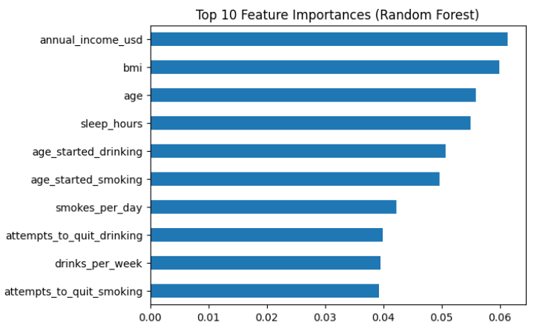
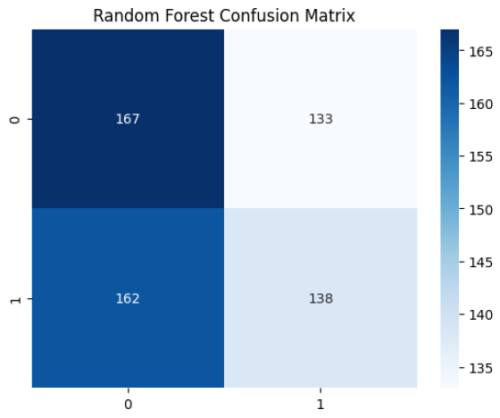
Predictive Modeling & Key Results
Model Selection: Logistic Regression, Classification Trees.
Feature Engineering: Categorical encoding, numerical scaling.
Evaluation Metrics: Accuracy, Precision, Recall, F1-Score, ROC AUC.
Key Predictors: smokes_per_day, bmi, age.
Model Performance: Logistic Regression: 49% accuracy (AUC ~0.51). Random Forest: 51% accuracy (AUC ~0.50). Performance is close to random guessing, indicating lack of meaningful classification.
7

Slide 8
Results & Conclusion
1.
2.
3.
Successfully predicted health risks using ML algorithms.
Emphasized comprehensive evaluation metrics.
Identified smokes_per_day, bmi, age as key risk factors.
4.
5.
Model provides valuable insights for public health interventions.
Enables targeted prevention strategies.
8

Slide 9
Thank you for your attention!
We are now open for any questions.

